Slide 1
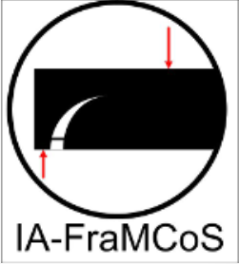

11th international conference on fracture mechanics of concrete and concrete structures, 10-14th Sept 2023, IISc Bangalore
Numerical Modeling of Flexural behaviour of Textile Reinforced Concrete
Manas Bhadury (M.S. Student)
Keerthana Kirupakaran, Nerswn Basumatary and Tamali Bhowmik
Department of Civil Engineering
Indian Institute of Technology Madras, Chennai India

Slide 2
Outline
Introduction
Literature review
Research gap
Objectives
Methodology
Finite element model
Parametric analysis
Summary and conclusions

Slide 3
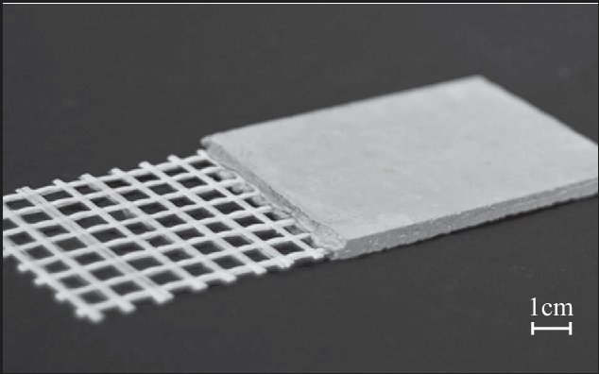
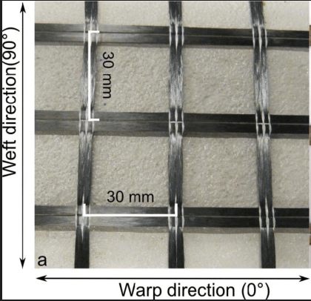
Introduction
What is TRC?
Why TRC ?
Textile reinforced concrete
More load carrying capacity
More ductility
Lightweight
Fine grained concrete
( Aggregate size<2 mm)
Textile
Yarn
Scheerer et al.

Slide 4
Introduction: Why numerical modelling?
Number of specimens=4
Number of textile layers=4
Different mesh type=4
Type of loading rate=4
For each mechanical behaviour
No. of Experiments = 4^4=256
Time consuming and expensive
Way-out ?
Numerical modeling

Slide 5
Literature – Numerical models
Macro scale models
ACK model
OH model
Matrix
Matrix
Monolithic reinforcement
One interface
Sleeve filament
Two interface
Core filament
Sleeve filament
Matrix
Matrix
Von et al.

Slide 6
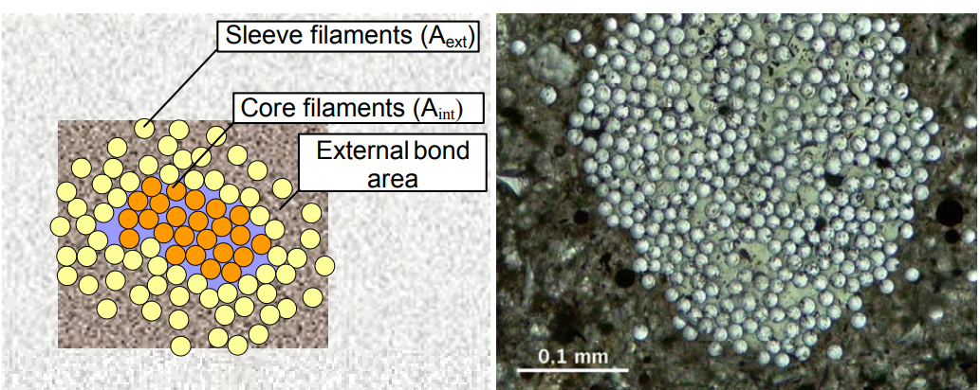
Literature – Bond
Bond in TRC
Banholzer et al.

Slide 7
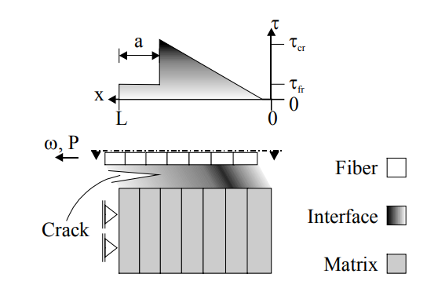
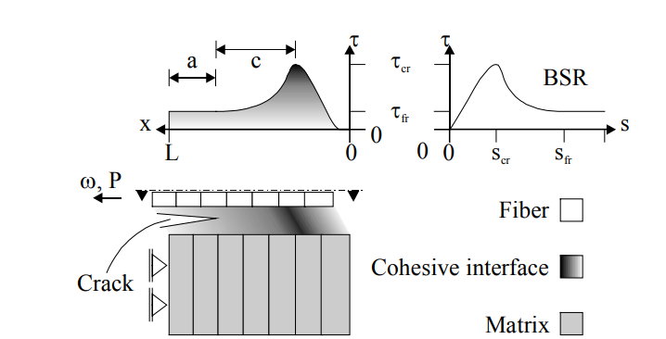
Literature – Bond
Analytical bond models
Perfect interface model
Fracture mechanical model
Cohesive interface model
No de-bonding
Not suitable
Banholzer et al.

Slide 8
Literature – Numerical models
Case Study 1
Case Study 2
P
P
P/2
P/2
P/2
P/2
270
400
270
185
400
185
Textile layer
4-Point bending test setup
Portal et al.(2013,2017)

Slide 9
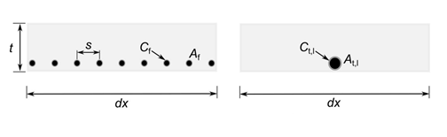
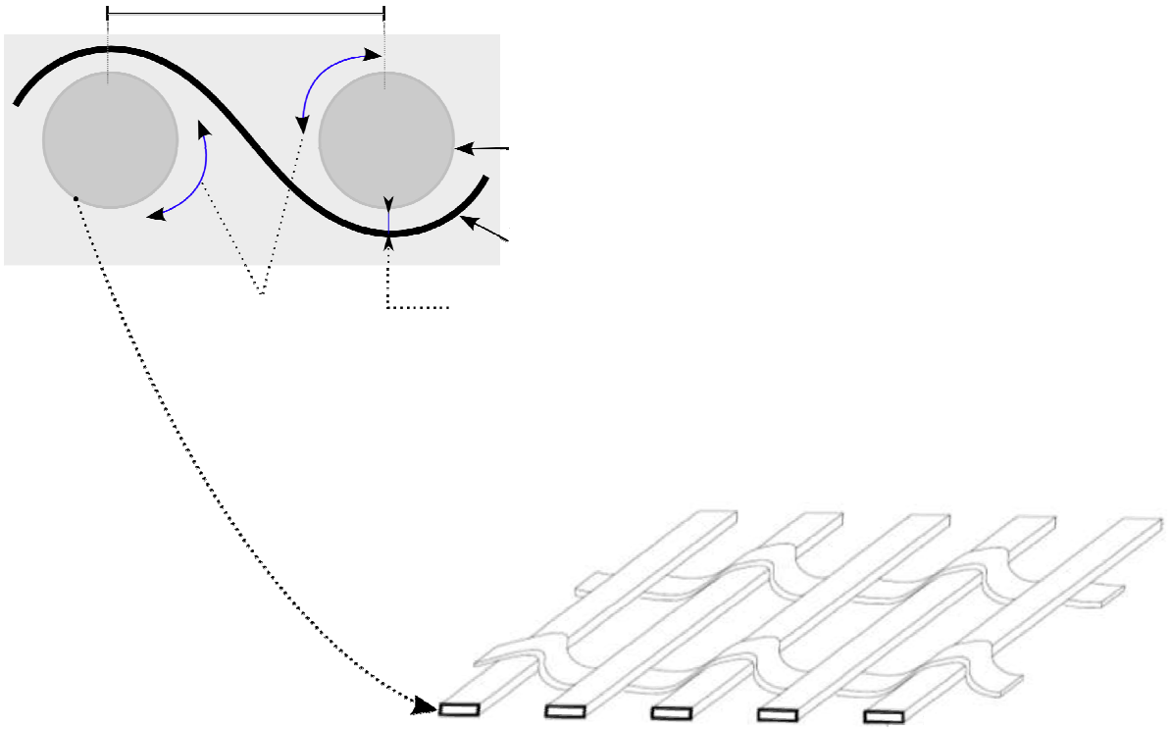
Literature – Textile modelling(ACK approach)
Case study-1
Case study-2
Warp spacing
Welft
Warp
Multi-yarn
Monolithic bar
Contact between yarns
Penetration of concrete matrix
Rectangular contact perimeter
Portal et al.

Slide 10
Literature – Textile modelling(ACK approach)
Case study-1
Case study-2
Plateau
σ
E
σ
E
τ
Linear elastic constitutive law with no limiting strength
τ
Bi-linear stress-strain curve
Possibility of textile rupture
Useful to predict bond failure
Portal et al.

Slide 11
Research gap
Most of the studies have been incorporated to simulate flexural behaviour of the carbon textile reinforced concrete. Flexural behaviour needs to be simulated for glass fiber TRC to incorporate it’s structural applications.
Influence of number of textile layers on flexural performance of TRC has not been considered in most of the studies.

Slide 12
Objectives
To simulate the flexural behaviour of textile reinforced concrete by incorporating a macro scale model using ACK approach.
To study the effect of textile layers on flexural performance through numerical modelling.

Slide 13
Methodology
Defining 2D/3D Model
Material properties
Create geometry
Assign section
Assemble
Interaction
Pre-processing
Loading and boundary condition
Redesign
Check error
Mesh
Analysis
Post-processing
Results
Priyanga et al.

Slide 14
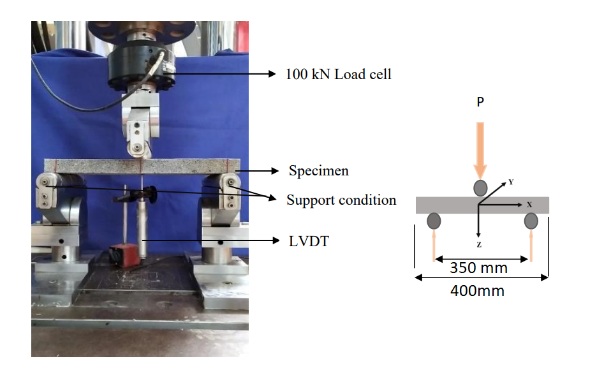
Finite element model
Model geometry in DIANA FEA
Experimental setup: Three point bend test
Nerswn Basumatary

Slide 15
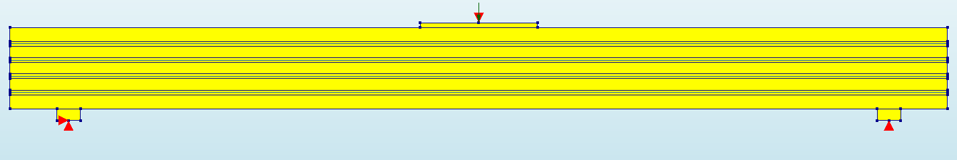
Finite element model
Model geometry in DIANA FEA
4 Textile layers

Slide 16
Finite element model
Support and load modelling
Load plate and support plate-
To prevent stress concentration

Slide 17
Finite element model-ACK approach
Idealization of textile modelling
S
C_{f}
A
C
A_{f}
dx
dx
Schematic of multi-yarn layer
Schematic of monolithic bar
t
t
dx
dx
Multi-yarn layer
4 no. of monolithic bar

Slide 18
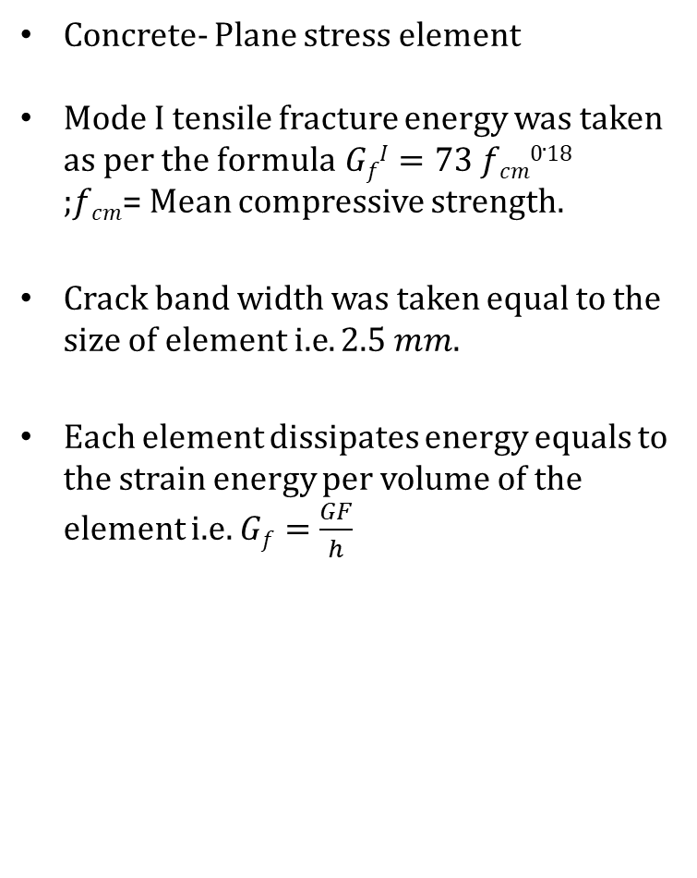
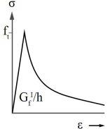
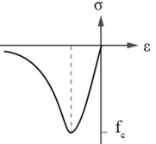

Finite Element Model-model parameters
Concrete
Total strain rotating crack model
Tensile
Compressive
;$h$= size of element.
Hordijk constitutive law
Thorenfeldt constitutive law
Hordijk curve
Thorenfeldt curve

Slide 19
Finite Element Model:model parameters
Zone with reduced tensile strength(by 15%)

Slide 20
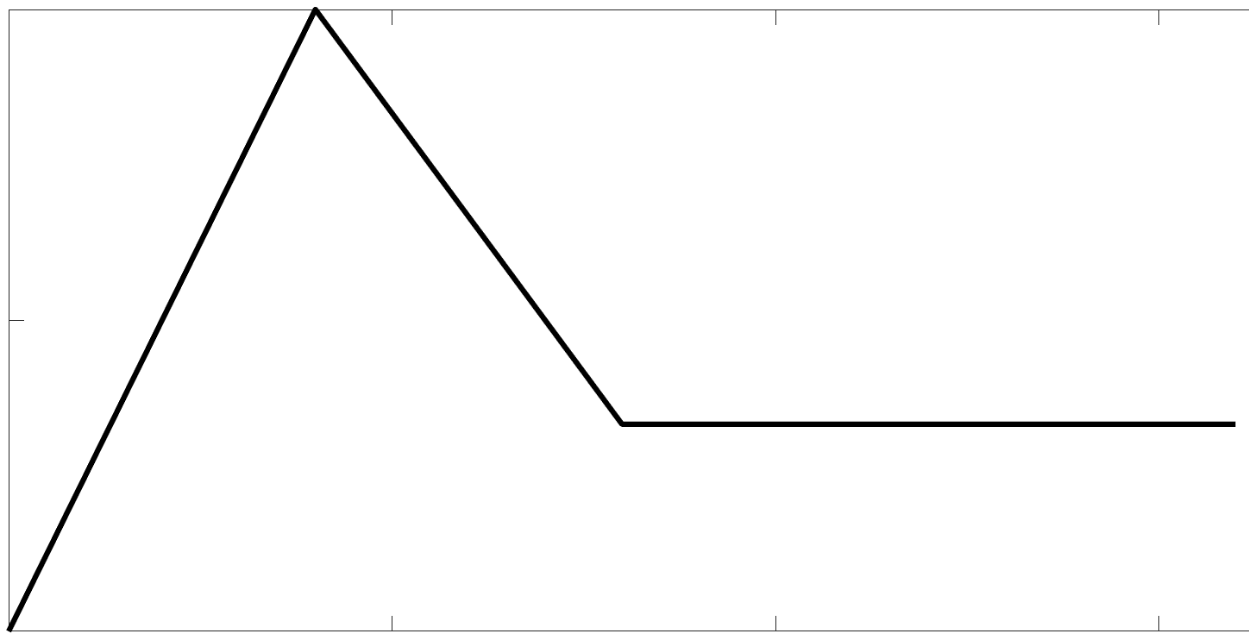
Finite Element Model-model parameters
Textile
Reinforcement bar
Bond-slip interface
20
σ
E
10
Bond stress(N/mm²)
τ
0
0.5
0
1
1.5
Linear elastic constitutive law with no limiting strength
Relative slip(mm)

Slide 21
Finite Element Model-loading parameters
Deformation controlled
Total deformation of 5 mm is applied in 500 load steps.

Slide 22
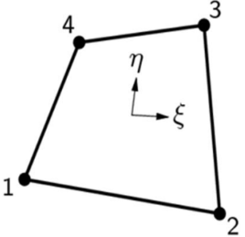
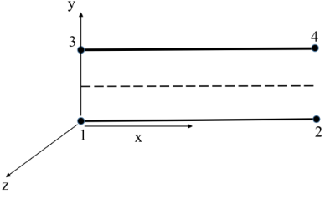
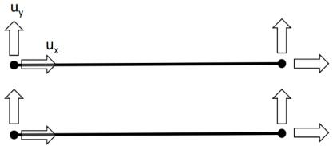
Finite element model
Type of elements
Component | No. of elements
Panel | 2240 no. of Q8MEM elements
Load plate | 20 no. of Q8MEM elements
Support plate | 16 no. of Q8MEM elements
Interface between load plate and panel | 20 no. of L8IF elements
Textile reinforcement | 640 no. of bar elements
Q8MEM
L8IF

Slide 23
Finite Element Model-Analysis
Analysis
Non-linear analysis
Secant( Quasi-newton) method
Convergence norm
Energy=0.001
Displacement=0.01
Force=0.01

Slide 24
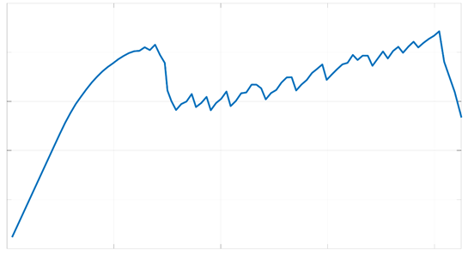
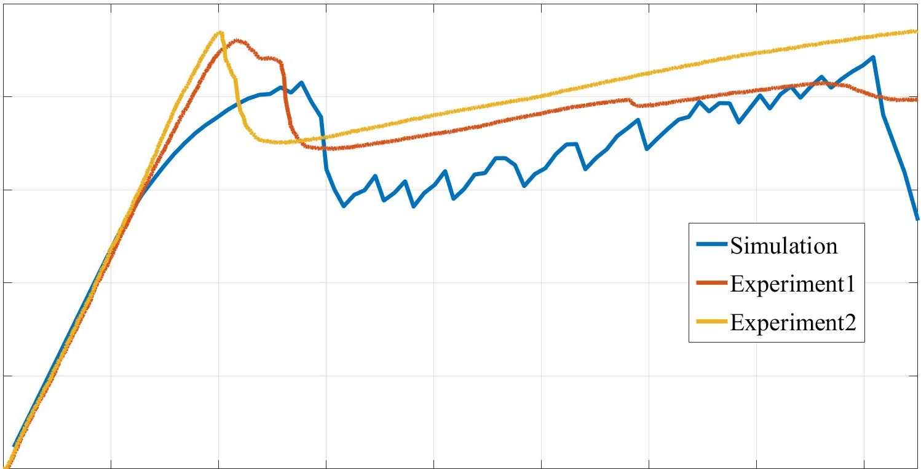
Finite element model
Model result and validation
2.5
C
2.5
A
2
2
1.5
1.5
Load (kN)
B
Load (kN)
1
OA-Zone 1
OB-Zone 2
OC-Zone 3
1
0.5
0.5
0
O
0
0
0.2
0.4
0.6
0.8
0
0.2
0.4
0.6
0.8
Mid Span deflection (mm)
Mid Span deflection (mm)
Results | Experimental | Numerical | Difference(%)
1st Crack Load(N) | 2.273 | 2.076 | 8.65
Deflection at 1st Crack(mm) | 0.20 | 0.28 | 39.30
Load at 0.8 mm deflection(N) | 2.321 | 2.213 | 4.66

Slide 25
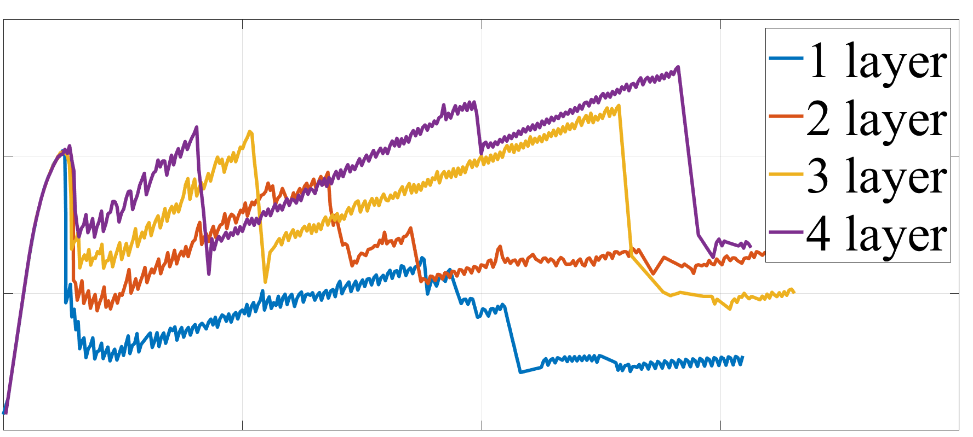
Parametric analysis
3
2
Load (kN)
1
0
0
1
2
3
Mid span deflection (mm)
Parametric analysis: Changing the number of layers of textile

Slide 26
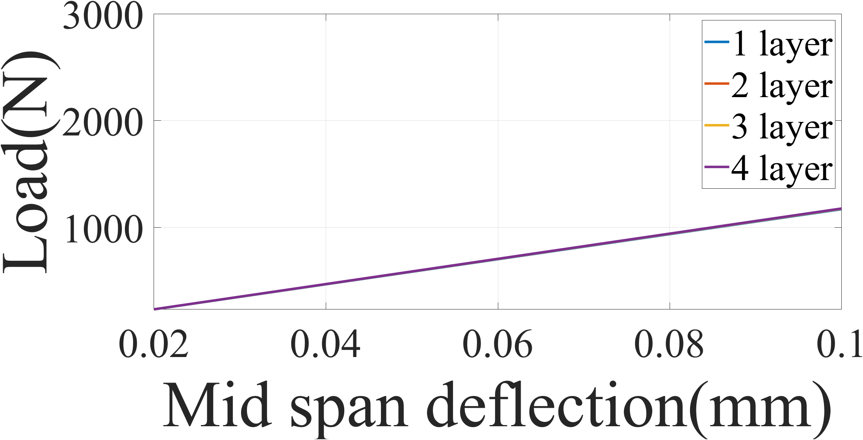
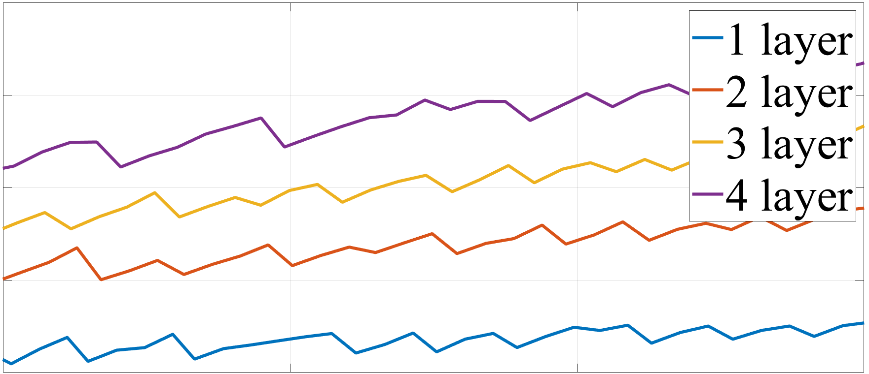
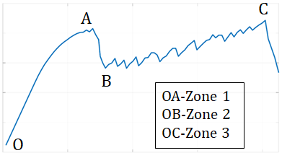
Parametric analysis
Zone 1-OA
Zone 3-AB
3
2.5
2
k1=540.25 N/mm
2
Load (kN)
Load (kN)
1.5
k2=1047.33 N/mm
k3=1401.745 N/mm
1
1
k4=1630.87 N/mm
0.5
0.02
0.04
0.06
0.08
0.1
0.5
0.6
0.7
0.8
Mid span deflection (mm)
Mid span deflection (mm)
3
2
Load (kN)
1
0
0
1
2
3
Mid span deflection (mm)
Parametric analysis: Changing the number of layers of textile

Slide 27
Summary and conclusions
Flexural behaviour of textile reinforced concrete has been simulated using macro-scale finite element model based on monolithic bar approach.
The finite element model predicts load-deflection behaviour upto 0.8 mm deflection.
Based on the parametric analysis, it can be concluded that the slope of the strain hardening zone decreases as the number of layers are decreased.

Slide 28
THANK YOU

Slide 29
Questions?

